Slide 1



coco
shot

Slide 2

ABOUT US

Slide 3

Who are we...?

Slide 4
“Get ready to taste the tropics with our latest venture - introducing the newest sensation in coconut cuisine! At our brand-new COCO SHOT foods company”

Slide 5
WHAT WE DO ...?

Slide 6
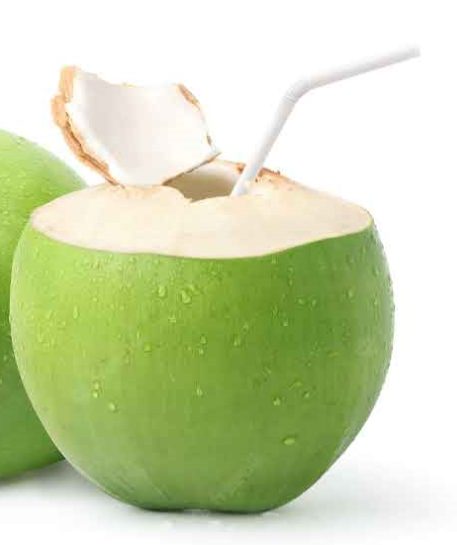
“we're on a mission to bring the exotic flavors of the coconut to your table. From creamy coconut milk to melty ice cream, our products are crafted with the finest ingredients and a commitment to quality. Welcome to a world of coconut-infused goodness - where every dish is a taste of sunshine and pure delight!”

Slide 7
OUR VISION
We want to provide the best quality and hygienic nuts and dry fruit products to every Indian family and make them healthy
And we want to support farmers by increasing their productivity
To reach our Indian COCO SHOT to each Indian family

Slide 8

OUR USP
Tender coconut ice cream
Tender Coconut pudding
Coconut Popsicles
Tender COCO Shot

Slide 9

Study Case
Steps
case
Observe
Question
Develop
Mind Mapping
Target Market
Approved
Final
Project
Research
Feature
Result

Slide 10













LOGO
Abstract logo marks
cocnut
Fresh
Nature
TAG LINE
The Real Flavor Of Paradise
Stay Hydrated
99% Pure,1% Love
COCO
BRAND COLOUR
Green
Blue
Orange
BRAND NAME B Fresh
KOKO Fresh
COCO SHOT
SHOT
PRODUCTS
COCO smoothies
COCO puddings
Tender COCO water
COCO CAKES
TARGET AUDIANCE
Every Indian Family

Slide 11
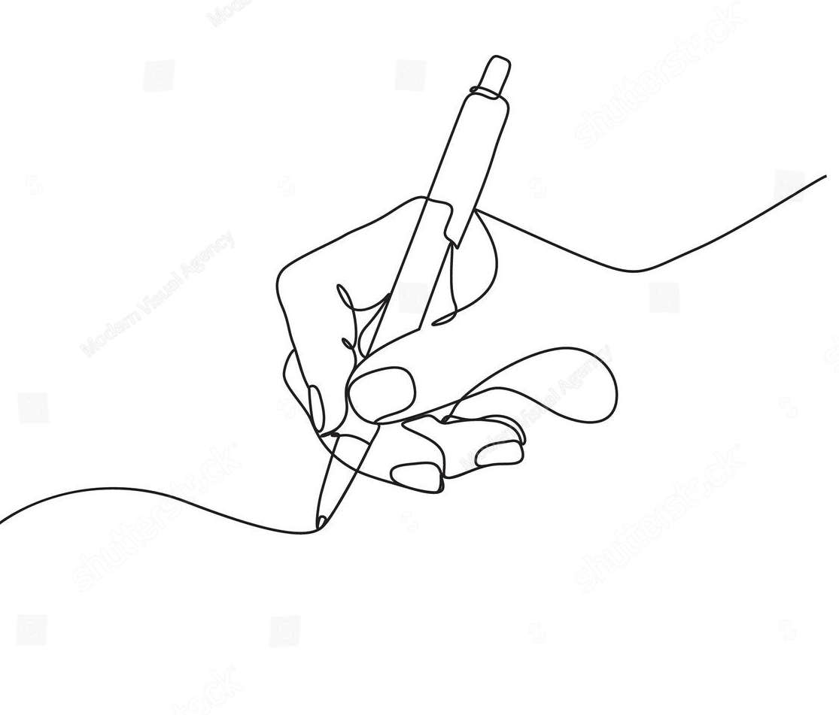
Sketches

Slide 12
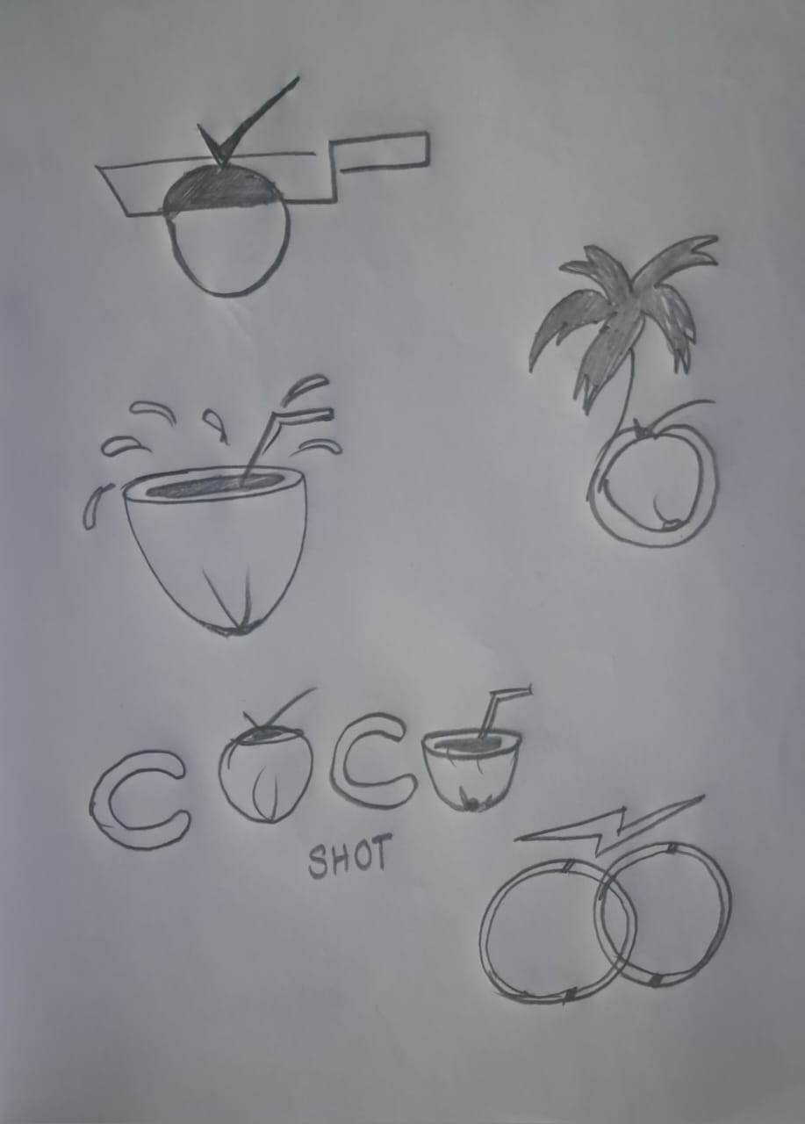


Slide 13
LOGO

Slide 14
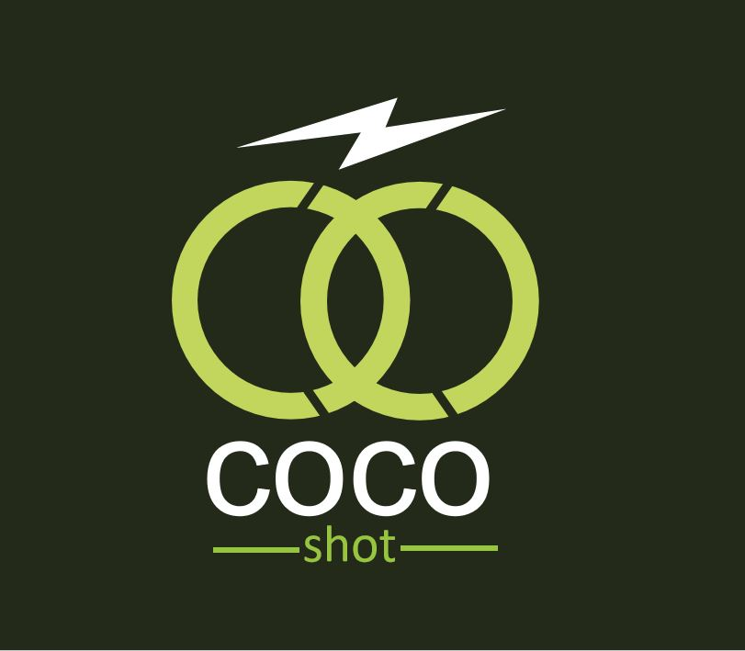
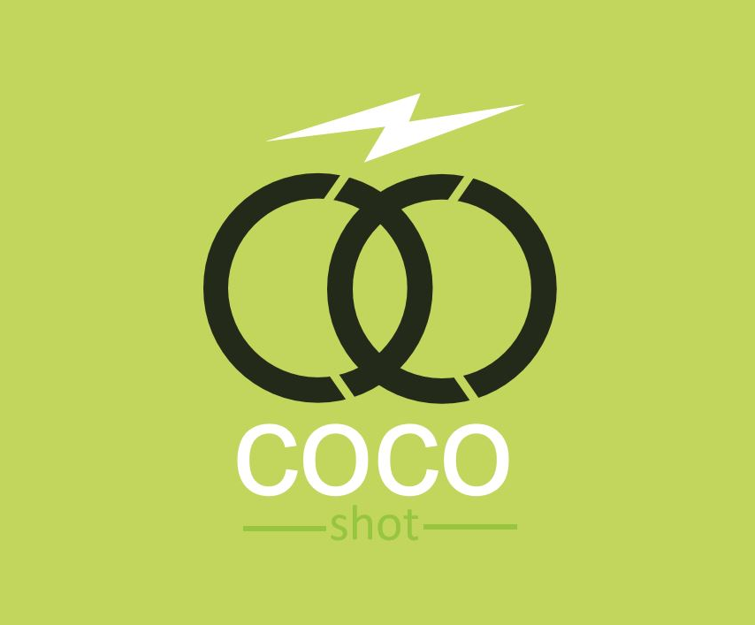
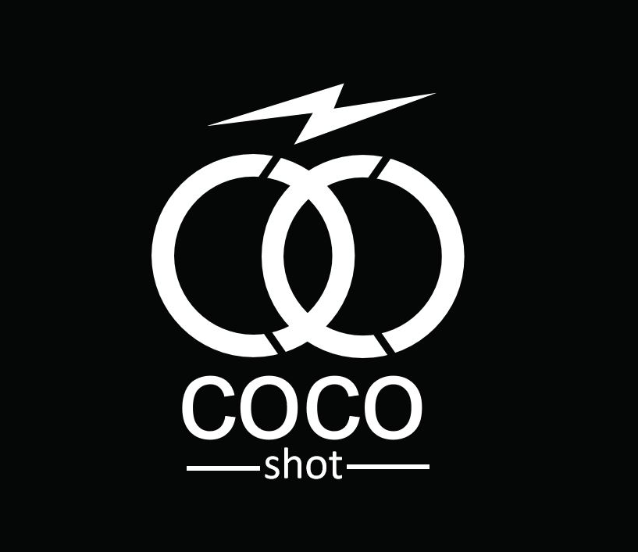
LOGO ON DARK BACKGROUND

Slide 15

COCO SHOT

Slide 16
COCO SHOT could represent a brand or product line focused on fresh coconut products , like concentrated coconut water or energy shots infused with coconut extracts.
The name suggests a quick, convenient way to get a boost of energy and hydration, with the tropical flavor and natural properties of coconut as the key ingredient.
Our logo and branding will convey this sense of vitality and refreshment, with imagery evoking coconuts or energetic design elements like bursts or splashes.
Overall, COCO SHOT embodies a dynamic, refreshing approach to wellness and energy supplementation

Slide 17

LOGO EXPLANATION

Slide 18
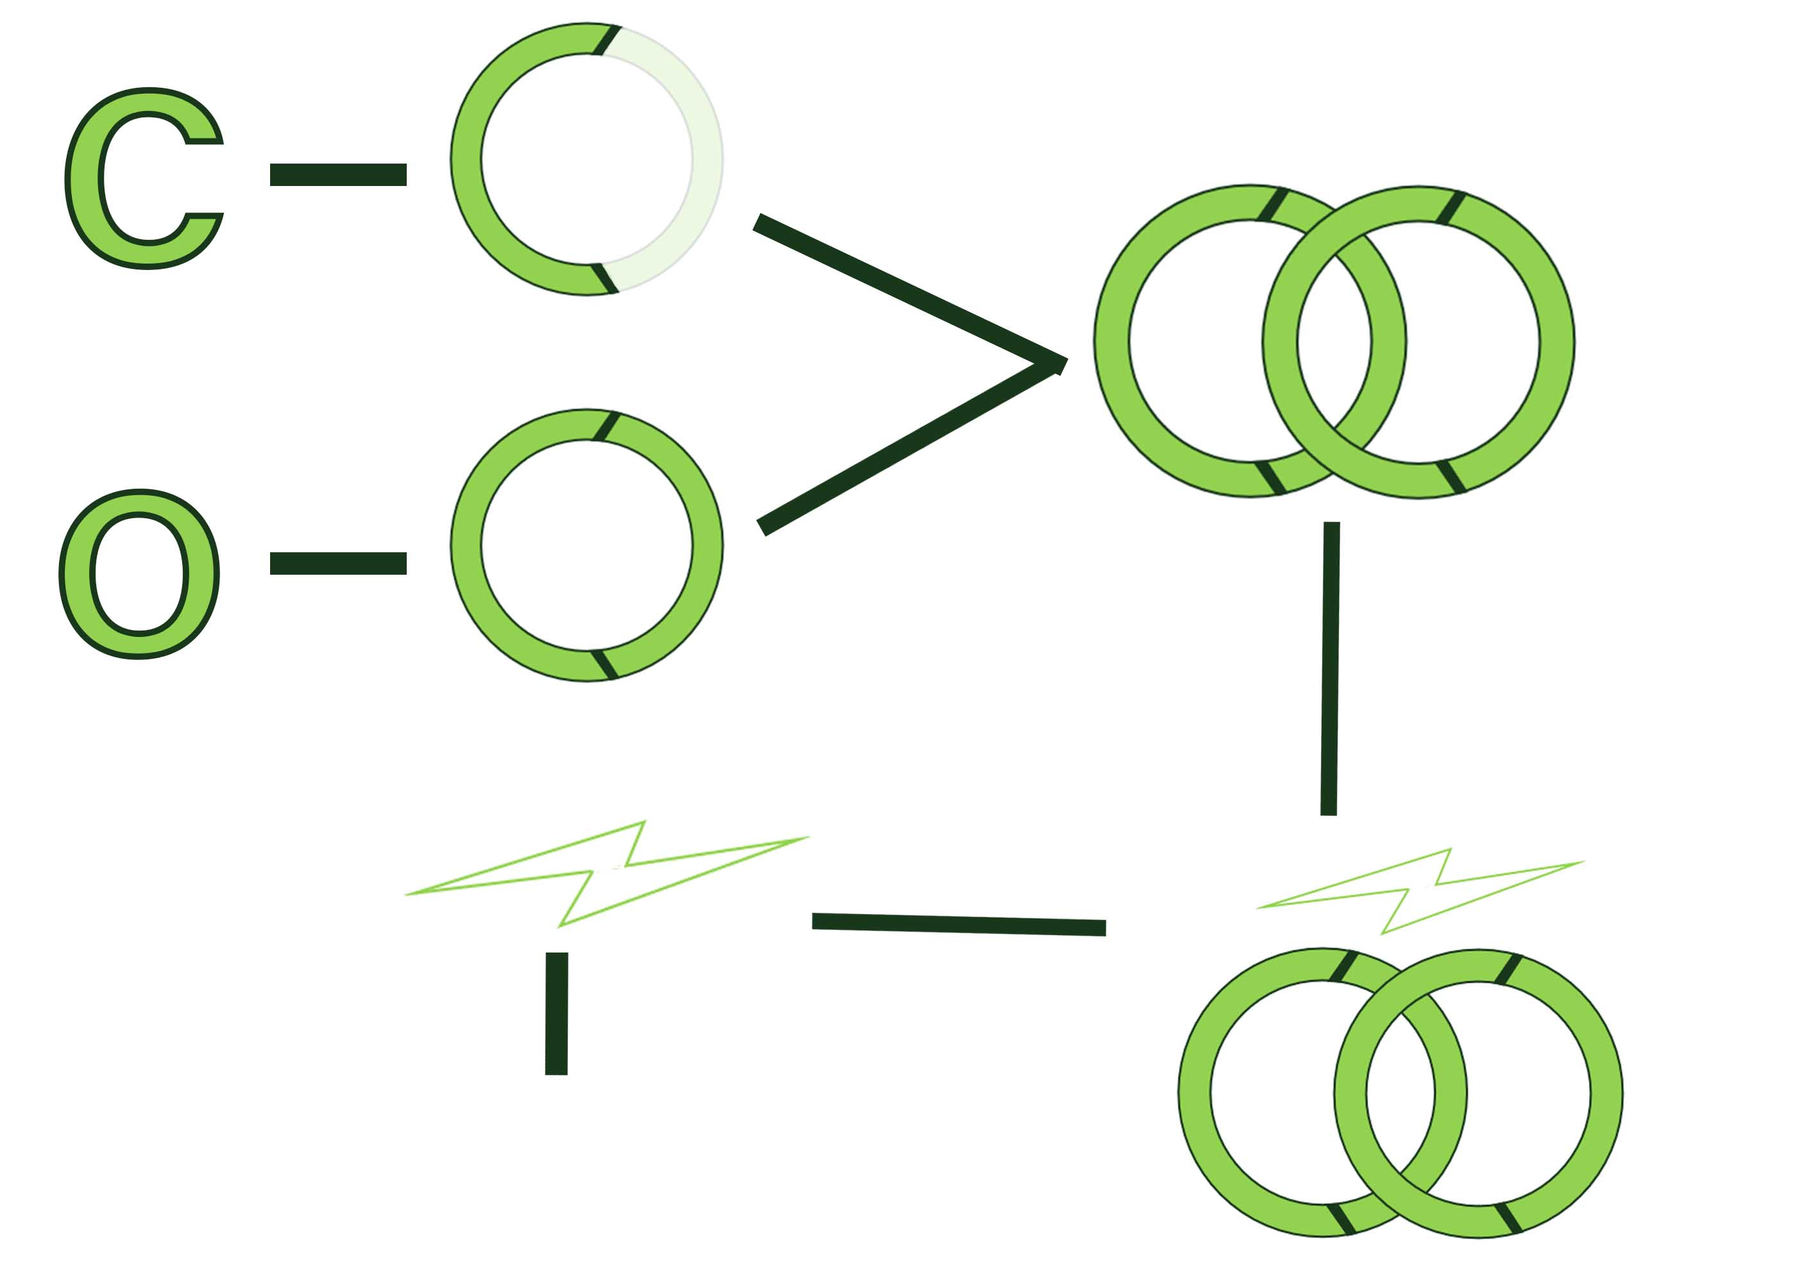
Lighting symbol represent our drink’s ability to provide a QUICK and REFRESHING burst of HYDRATION and INSTANT ENERGY
It also represent the NATURAL ENERGY and vitality associated with coconuts,as well as the tropical orgins of our product

Slide 19
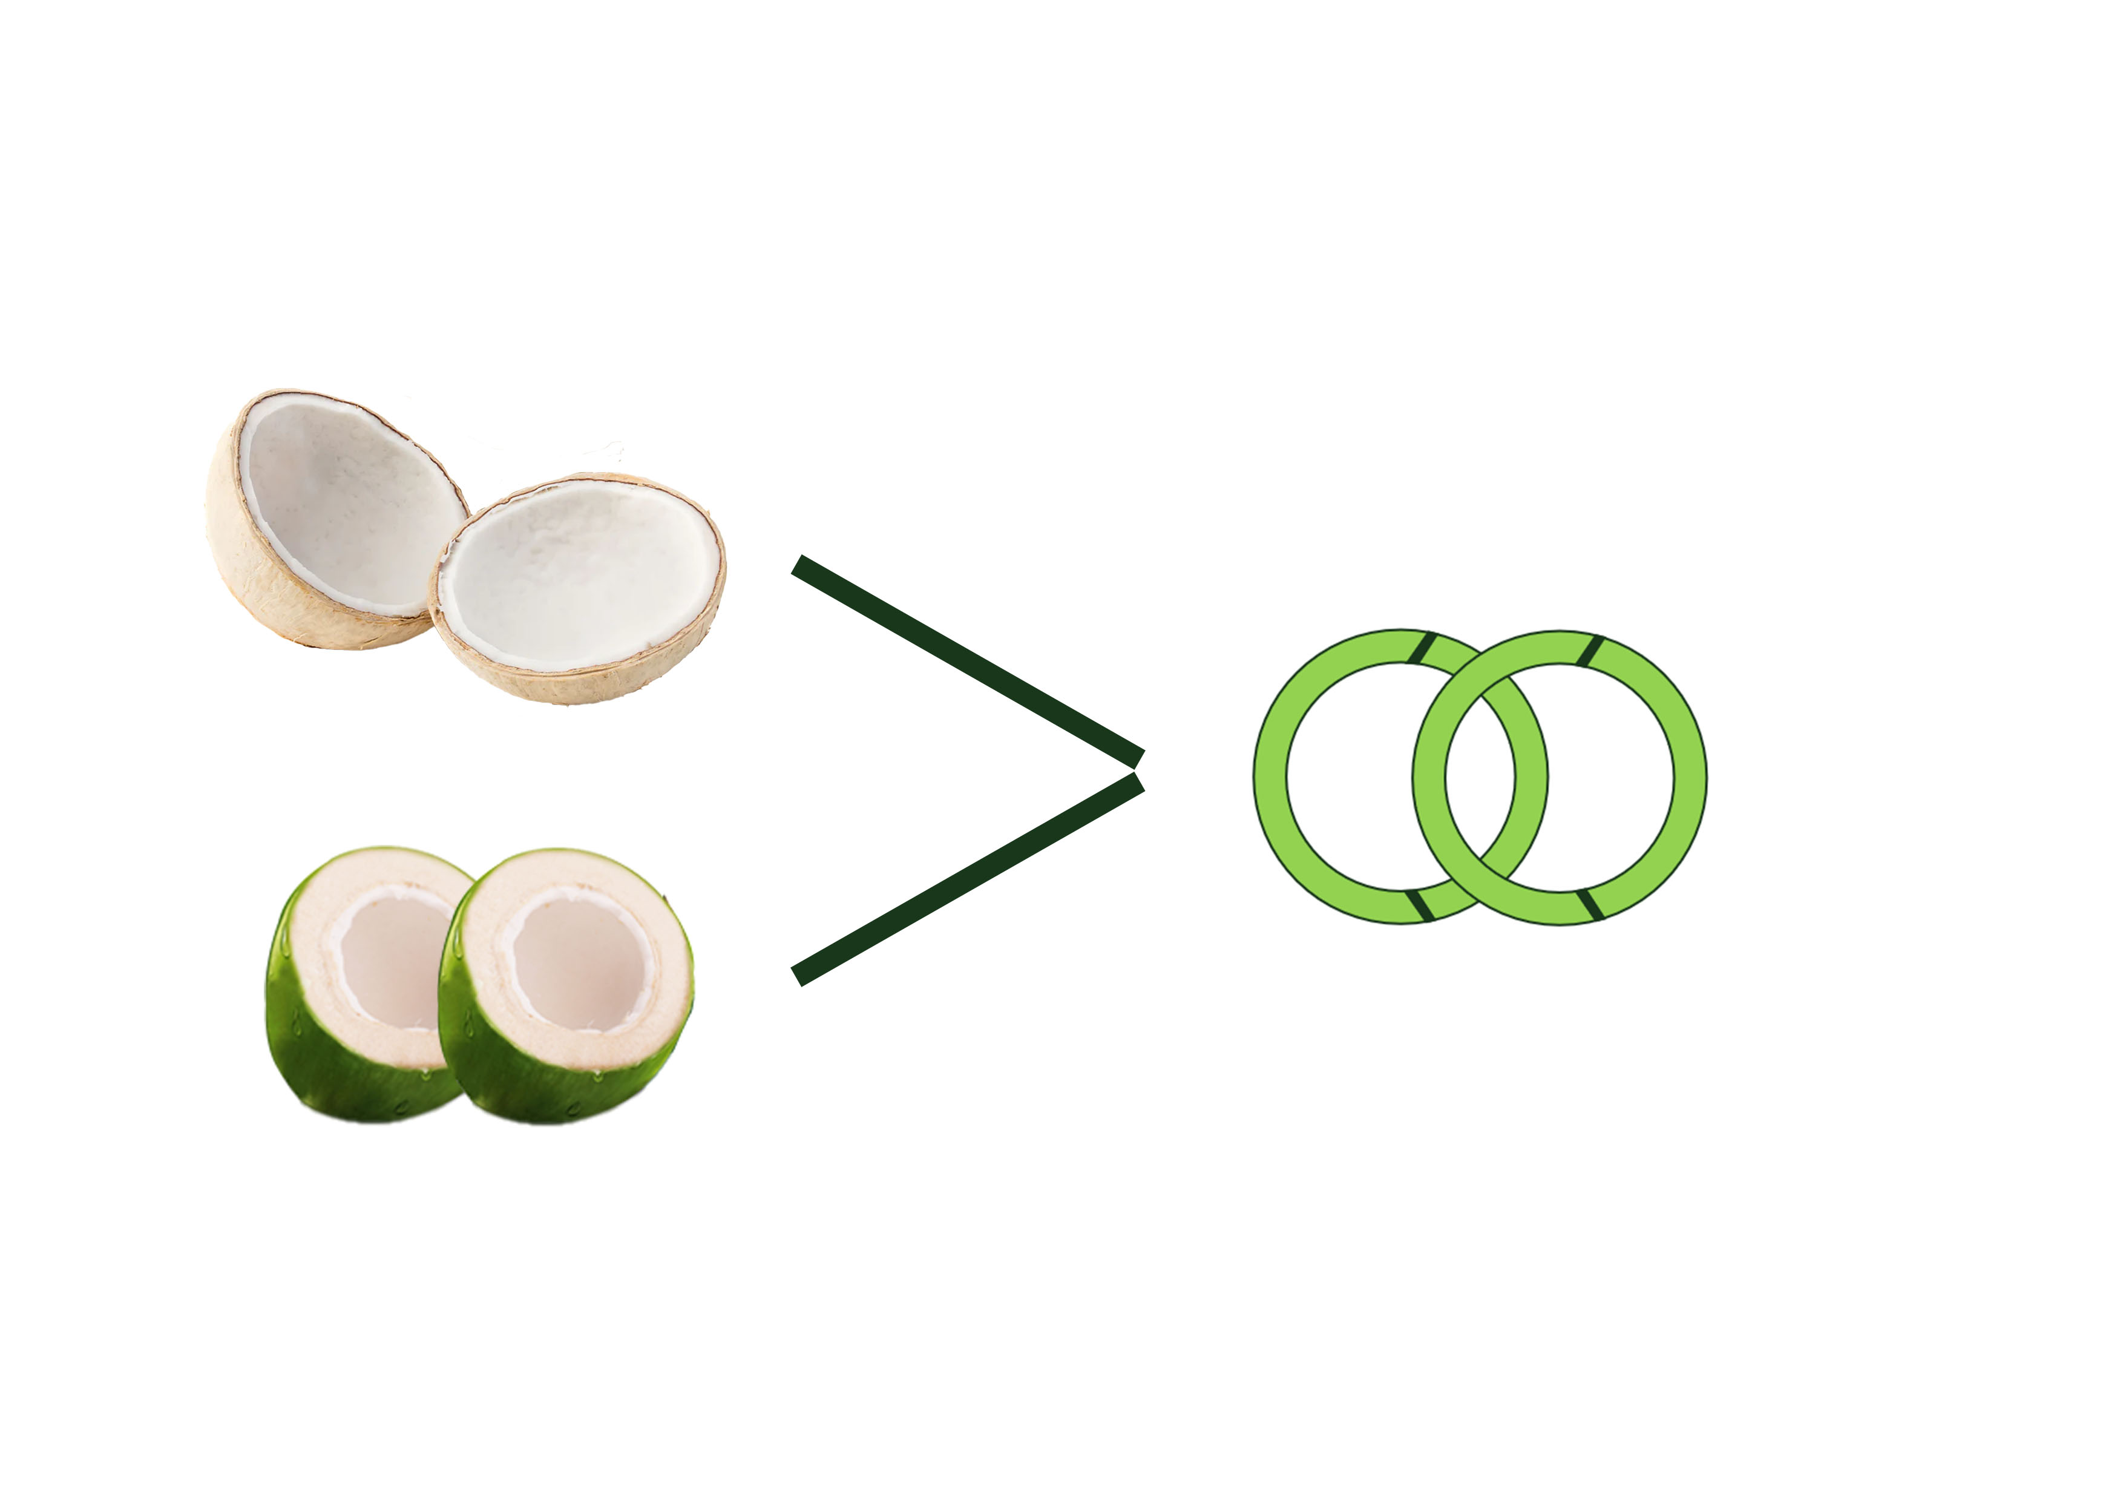

Slide 20
REFERENCE

Slide 21
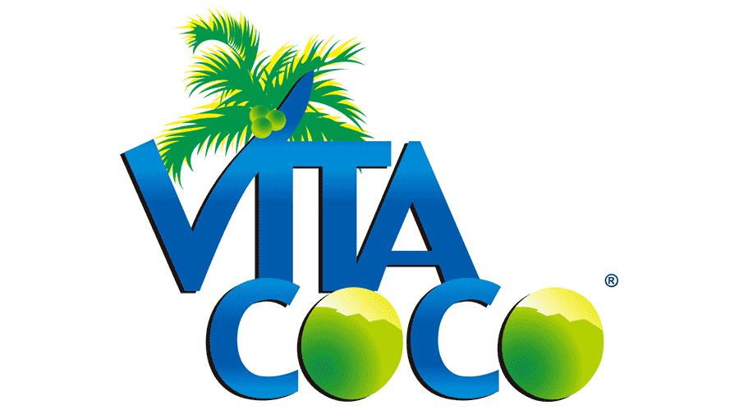


LOGO REFERENCE

Slide 22
EXPLANATION
COCO SHOT, the logo incorporate a coconut illustration, possibly split open to reveal its contents, with a vibrant, energetic color palette to reflect the brand's vitality and freshness.
The "SHOT" aspect could be emphasized with dynamic typography and suggesting quick, impactful consumption.
This combination communicates the essence of the brand: fast, flavorful, and nourishing coconut-based products that provide a burst of energy and satisfaction.

Slide 23
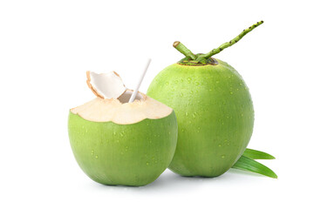

Color Reference
Color palets

Slide 24

Colour Scheme
Green Colour Family

Slide 25
Colour Scheme
COCO SHOT is created with a monochromatic colour
A monochrom colour pattle is a simple and fresh way of creating a killer branding
In terms of brand colour less is more usage ofsingle colour in branding that make stand out in the market,simplicity,elegent and consistency

Slide 26

Primary colour
Colour : wild lime
Hex code : 92d250
hex#92d250

Slide 27

Secondary colour
Colour : Myrtle
Hex code : 19371b
Myrtle
hex#19371b

Slide 28

EMAIL
cocoshot@gmail.com
Contact me
WEBSITE
www.cocoshot.com
PHONE
123-4567-890

Slide 29
Thank you

